Slide 1


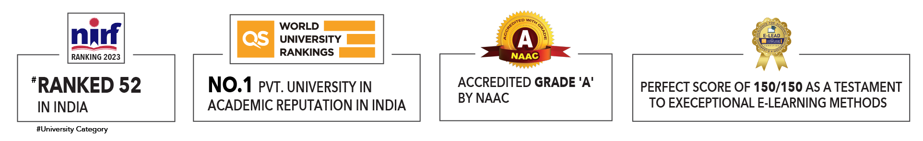

Slide 2

Unit 5 : Applications of AI and machine learning
Lecture 5: Defect detection and predictive maintenance
School of Computer Science UPES, Dehradun
India

Slide 3
Table of Contents
Overview of Artificial Intelligence in Energy & Utilities
Defect Detection and Predictive maintenance
Transforming the customer experience
Forecasting the water and energy consumption
AI-Powered increasing the efficiency of Energy Storage
Summary
Future Trends
MCQ’s

Slide 4
Learning & Course Outcomes
LO1: Explore AI applications in retail and supply chains.
LO2: Design traffic prediction model.
LO3: To evaluate route, optimize algorithm.
CO2: Explore the data analysis and preparation techniques, the logic of AI algorithms for solving practical problems.

Slide 5
Artificial Intelligence in Energy & Utilities
92% of companies are investing in AI or plan to do so within two years.
67% of energy executives see AI benefits in better customer experiences.
Over 50% benefit from improved decision-making and product innovation.

Slide 6
Defect detection and predictive maintenance
One of the challenges that the energy & utilities companies face is detecting suspect pipes/wiring/machines or defects in fault-susceptible processes. Breakages are costly for utilities in both financial capital and brand value. Defect detection becomes a priority for the field to avoid noticeable losses.
35% of energy executives are realizing AI’s benefits in performing predictive maintenance and automating routine tasks (33%). AI image recognition and computer vision systems allow to cost-effectively process photos and videos of the facilities to alarm employees if any breakage is concerned.

Slide 7
Defect detection and predictive maintenance
Defect detection and predictive maintenance are critical for ensuring the reliability, safety, and efficiency of operations across various industries.
Defect detection refers to the process of identifying flaws, faults, or abnormalities in equipment, machinery, or systems that could lead to failure or reduced performance if not addressed.
The primary goal is to detect issues early to prevent unplanned downtime, ensure safety, and maintain optimal performance.
Various techniques and technologies are used for defect detection, including visual inspections, non-destructive testing methods (e.g., ultrasonic, X-ray), and advanced imaging technologies (e.g., thermal imaging).

Slide 8
Defect detection and predictive maintenance
Predictive maintenance (PdM) involves monitoring the condition and performance of equipment during normal operation to predict and prevent potential failures before they occur.
The aim is to perform maintenance activities at the optimal time, thereby minimizing downtime, extending equipment life, and reducing maintenance costs.
PdM relies on data collected from sensors and other monitoring tools, which is then analyzed using various techniques, including statistical analysis, machine learning algorithms, and AI.

Slide 9
Defect detection and predictive maintenance
History and Evolution:
1. Early Maintenance Practices:
Reactive Maintenance: Initially, maintenance was largely reactive, performed only after equipment failed. This approach often led to significant downtime and high repair costs.
Preventive Maintenance: The next evolution was preventive maintenance, where maintenance tasks were performed at scheduled intervals regardless of the equipment's condition. This helped reduce unexpected failures but could still lead to unnecessary maintenance activities

Slide 10
Defect detection and predictive maintenance
History and Evolution:
2. Advent of Predictive Maintenance:
Condition Monitoring:
With advancements in technology, condition monitoring became possible, allowing for more accurate assessment of equipment health.
Data Analytics:
The integration of data analytics and machine learning enabled the development of predictive maintenance strategies, which use real-time data to predict failures and optimize maintenance schedules.

Slide 11
Defect detection and predictive maintenance
History and Evolution:
3. Current Trends:
IoT and Industry 4.0:
The Internet of Things (IoT) and Industry 4.0 have further revolutionized maintenance practices by providing more comprehensive and real-time data.
AI and Machine Learning:
The application of AI and machine learning in predictive maintenance has enhanced the accuracy of failure predictions and enabled more sophisticated analysis of complex systems.

Slide 12
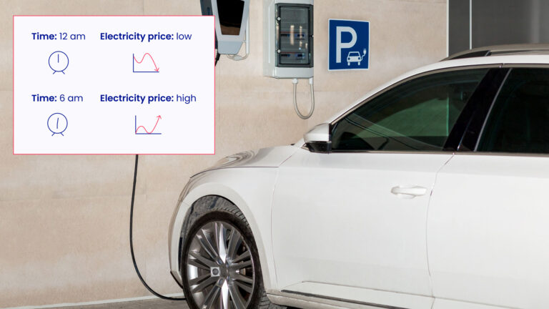
Transforming the customer experience
The utility suppliers can predict with the help of AI the consumption of water/heating/energy and thus come up with dynamic pricing to offer super low variants when there is excess capacity, for example.

Slide 13
Transforming the customer experience
AI provides a highly personalized view of those household interactions with different appliances through sophisticated disaggregation and customer segmentation. Thus, the customer, concerned with the bill size, could adjust and regulate their utility consumption in the most rational way.
For instance, artificial intelligence informs a utility that household A has an electric vehicle using a charger between midnight and 6 a.m. each night. Now, utility suppliers have the option to suggest those householders charge their EV earlier when electricity is cheaper.

Slide 14
Forecasting the water and energy consumption
Effective distribution of utility production can be a key to the sustainable growth of supplying companies. The energy consumption makes up 25-30% of total operation and maintenance (O&M) costs. AI can optimize runtimes of equipment so that they are only used when they are needed.

Slide 15
Forecasting the water and energy consumption
In the graph, you can see the example of a three-zone power system based on data from Great Britain. Supply and consumption have to match in real-time, excess power should be transmitted to the regions with higher demand, and energy transfers between regions are limited by network capacity.
Artificial intelligence is invited to create cost-effective strategies for scheduling the power consumption, with the potential savings of the consumer money, and accelerate decarbonization.

Slide 16
AI-Powered increasing the efficiency of Energy Storage
According to EPRI, current new-energy storage systems “are typically 4-hour duration or less, corresponding to peaking capacity and ancillary services needs. However, in the coming years as storage is deployed to replace higher capacity factor conventional generation, absorb longer periods of renewable overgeneration, and support resilience during severe weather events there is a potential need for longer duration storage.”
Material research, prototyping, testing, validation, and lifecycle assessment that used to take a lot of time in the labs can now be done in a virtual laboratory. Thus, it can speed up the research and development of new materials. Because of the rapid storage and release of energy from renewable sources, the requirements of high charge and discharge rates and low cost are becoming increasingly important. Thus, AI and ML are used to predict new battery material discovery and establish a new understanding of material behavior.

Slide 17
Summary
AI and ML are transforming transportation and logistics by enhancing efficiency, reducing costs, and improving safety. Key applications include traffic prediction, route optimization, supply chain optimization, and warehouse automation.
A digital twin is a virtual model of a physical asset, process, or system that mirrors its real-world counterpart. Continuously updated with data from sensors and other sources.

Slide 18
Future Trends
Ongoing advancements in technology will further enhance the capabilities of defect detection and predictive maintenance. Competitive Advantage: Companies that adopt these future trends will gain a competitive edge through improved efficiency, reduced costs, and enhanced reliability. Strategic Planning: Organizations should start planning now to integrate these future trends into their maintenance strategies to stay ahead in the industry.
New sensors are being developed that are more sensitive, accurate, and capable of detecting a wider range of parameters. These sensors can monitor parameters such as humidity, pressure, chemical composition, and more.
With more precise data, the predictive models become more accurate, leading to better maintenance decisions.

Slide 19
Future Trends
Continual improvement in algorithms that can learn from data and improve over time. Utilization of neural networks for complex pattern recognition in large datasets, enhancing defect detection capabilities.
Enhanced ability to predict failures with higher accuracy, even in complex and dynamic environments.

Slide 20
MCQ’s
1. Which of the following techniques is commonly used for defect detection in manufacturing processes?
A. Data Encryption
B. Ultrasonic Testing
C. Cloud Computing
D. Blockchain Technology
2. Predictive maintenance primarily aims to:
A) Increase the downtime of equipment
B) Replace parts regardless of their condition
C) Predict failures and perform maintenance before failures occur
D) Ignore historical data and rely solely on immediate observations

Slide 21
MCQ’s
3. What role does machine learning play in predictive maintenance?
A. It encrypts data for secure storage
B. It creates visual representations of data
C. It analyzes historical data to predict future equipment failures
D. It only monitors equipment without providing actionable insights
4. Which of the following sensors is commonly used for vibration analysis in predictive maintenance?
A) Temperature sensor
B) Pressure sensor
C) Accelerometer
D) Humidity sensor

Slide 22
MCQ’s
5. In predictive maintenance, a significant change in which parameter often indicates an impending failure?
A. Equipment color
B. Maintenance schedule
C. Equipment vibrations
D. Operator shift timings

Slide 23
MCQ’s
Answer: B. Ultrasonic Testing
Answer: C. Predict failures and perform maintenance before failures occur
Answer: C. It analyzes historical data to predict future equipment failures
Answer: C) Accelerometer
Answer: C. Equipment vibrations

Slide 24
References
https://scikit-learn.org/stable/modules/cross_validation.html
https://scikit-learn.org/stable/modules/model_evaluation.html
https://imbalanced-learn.org/stable/under_sampling.html
"Pattern Recognition and Machine Learning" by Christopher M. Bishop
"Feature Engineering for Machine Learning: Principles and Techniques for Data Scientists" by Alice Zheng and Amanda Casari

Slide 25

Thank You

